Slide 1
Discovering Today's Computers: Advances & Innovations
Md. Tanzim Hossain
ID: 011201341

Slide 2
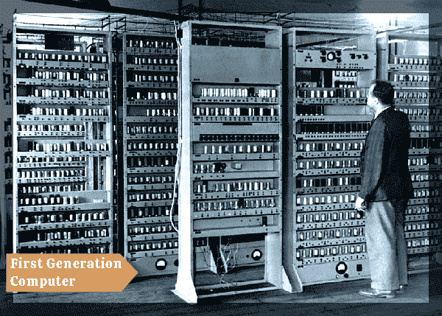
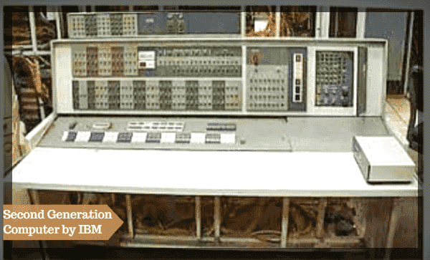
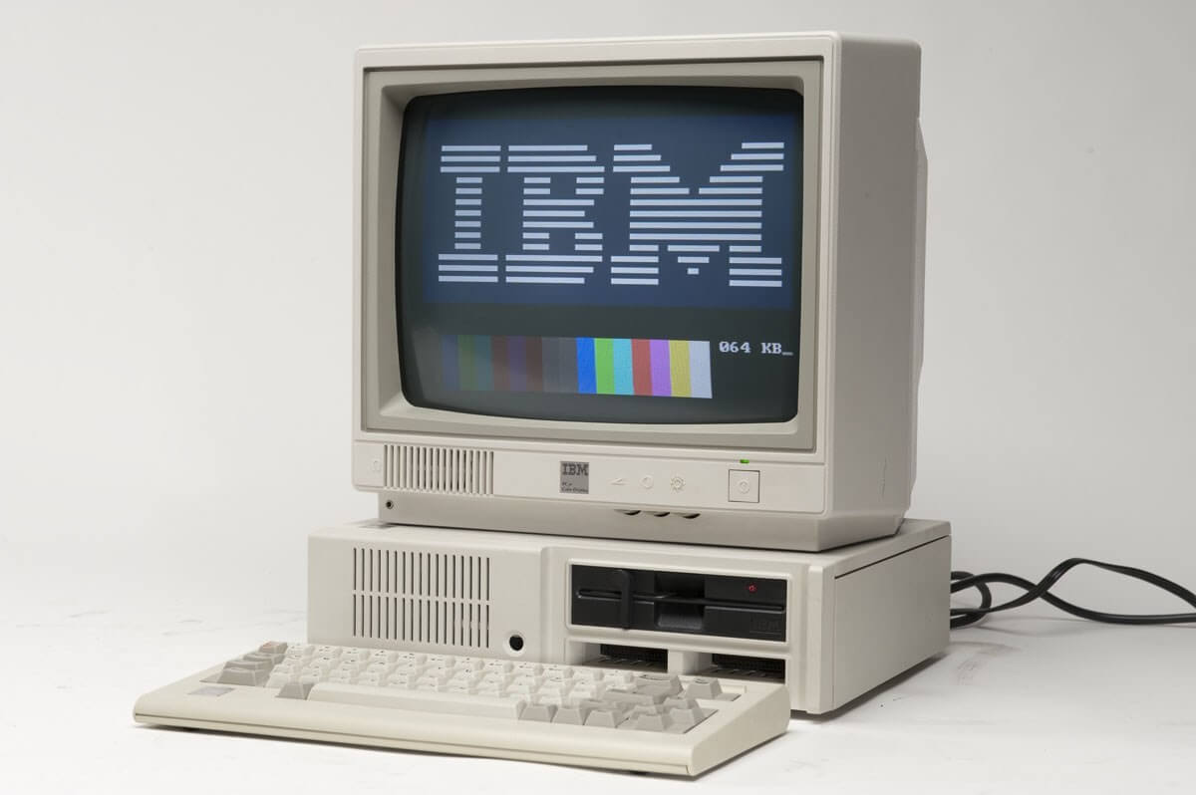
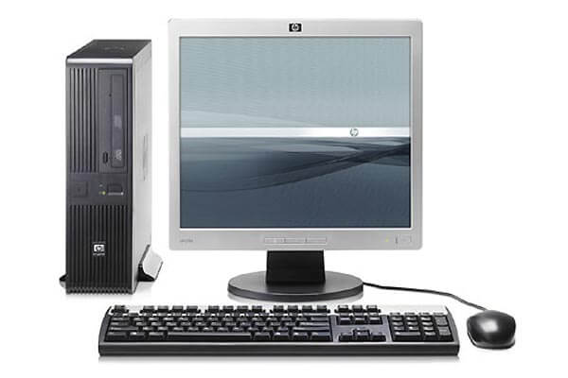
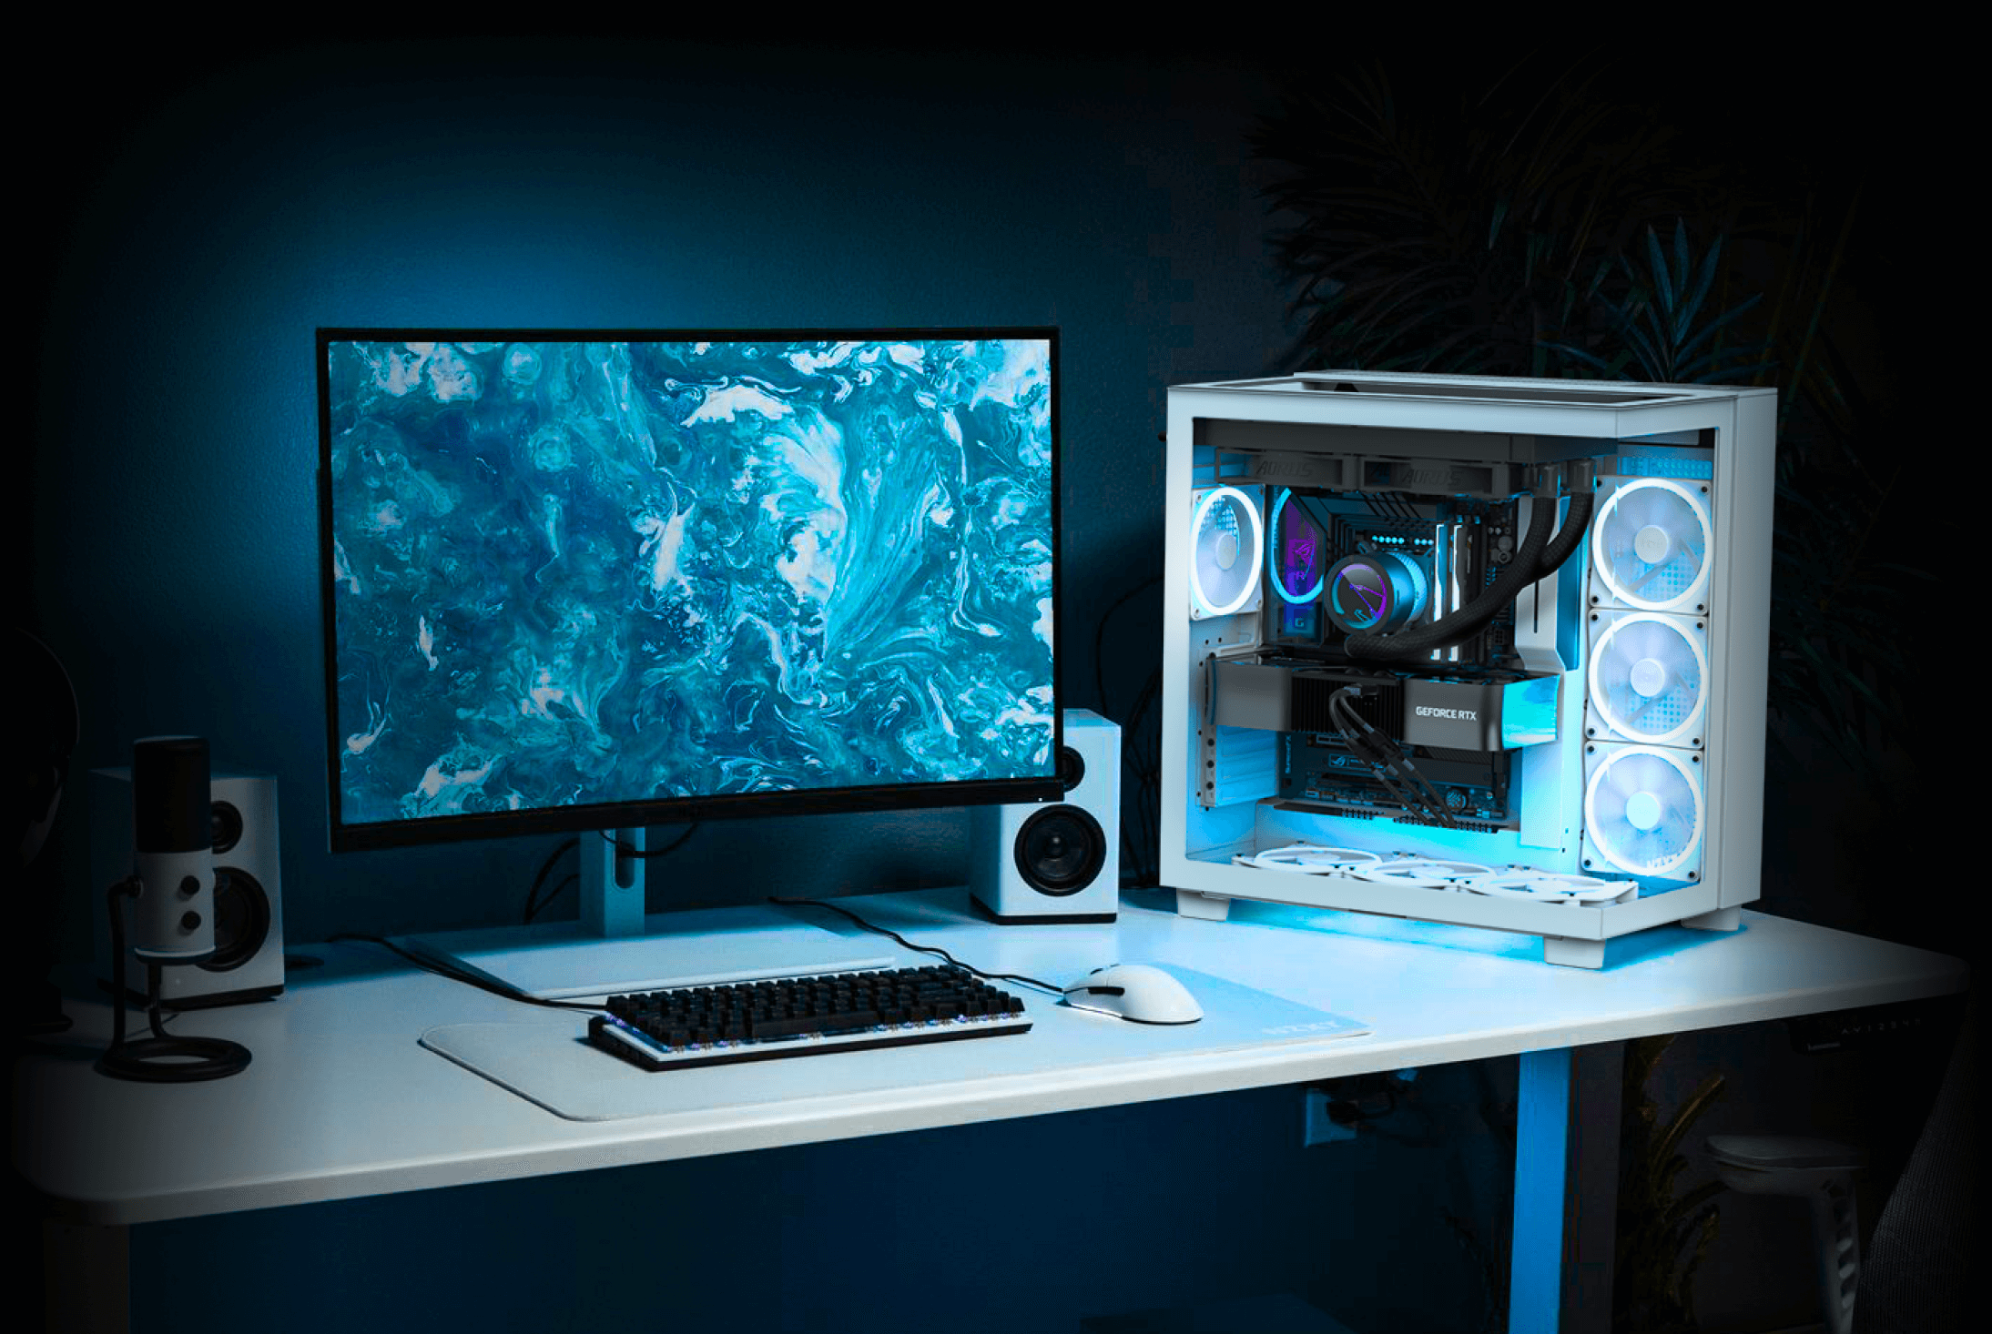
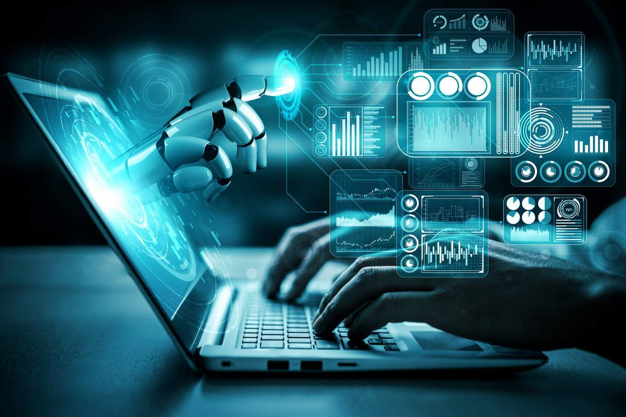
Computer Generation
1st Gen
2nd Gen
3rd Gen
5th Gen
4th Gen

Slide 3
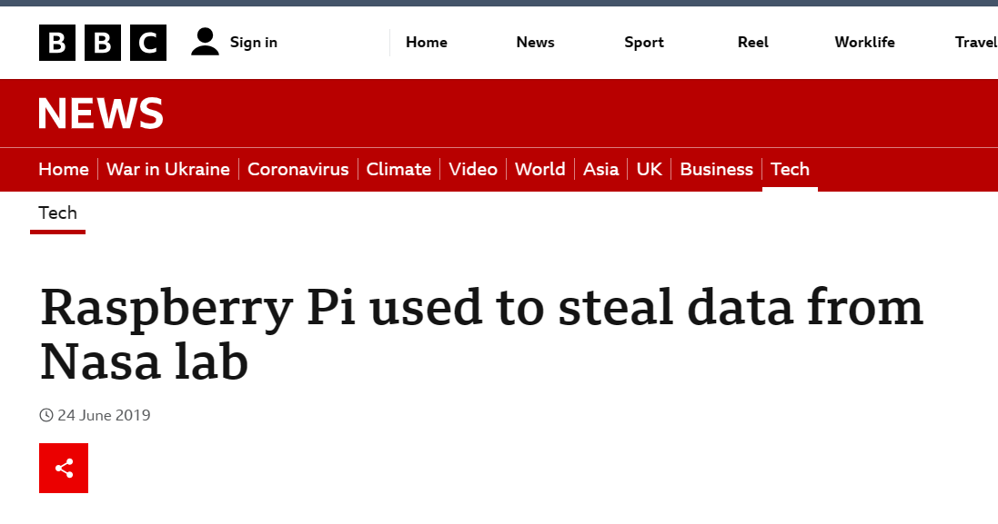
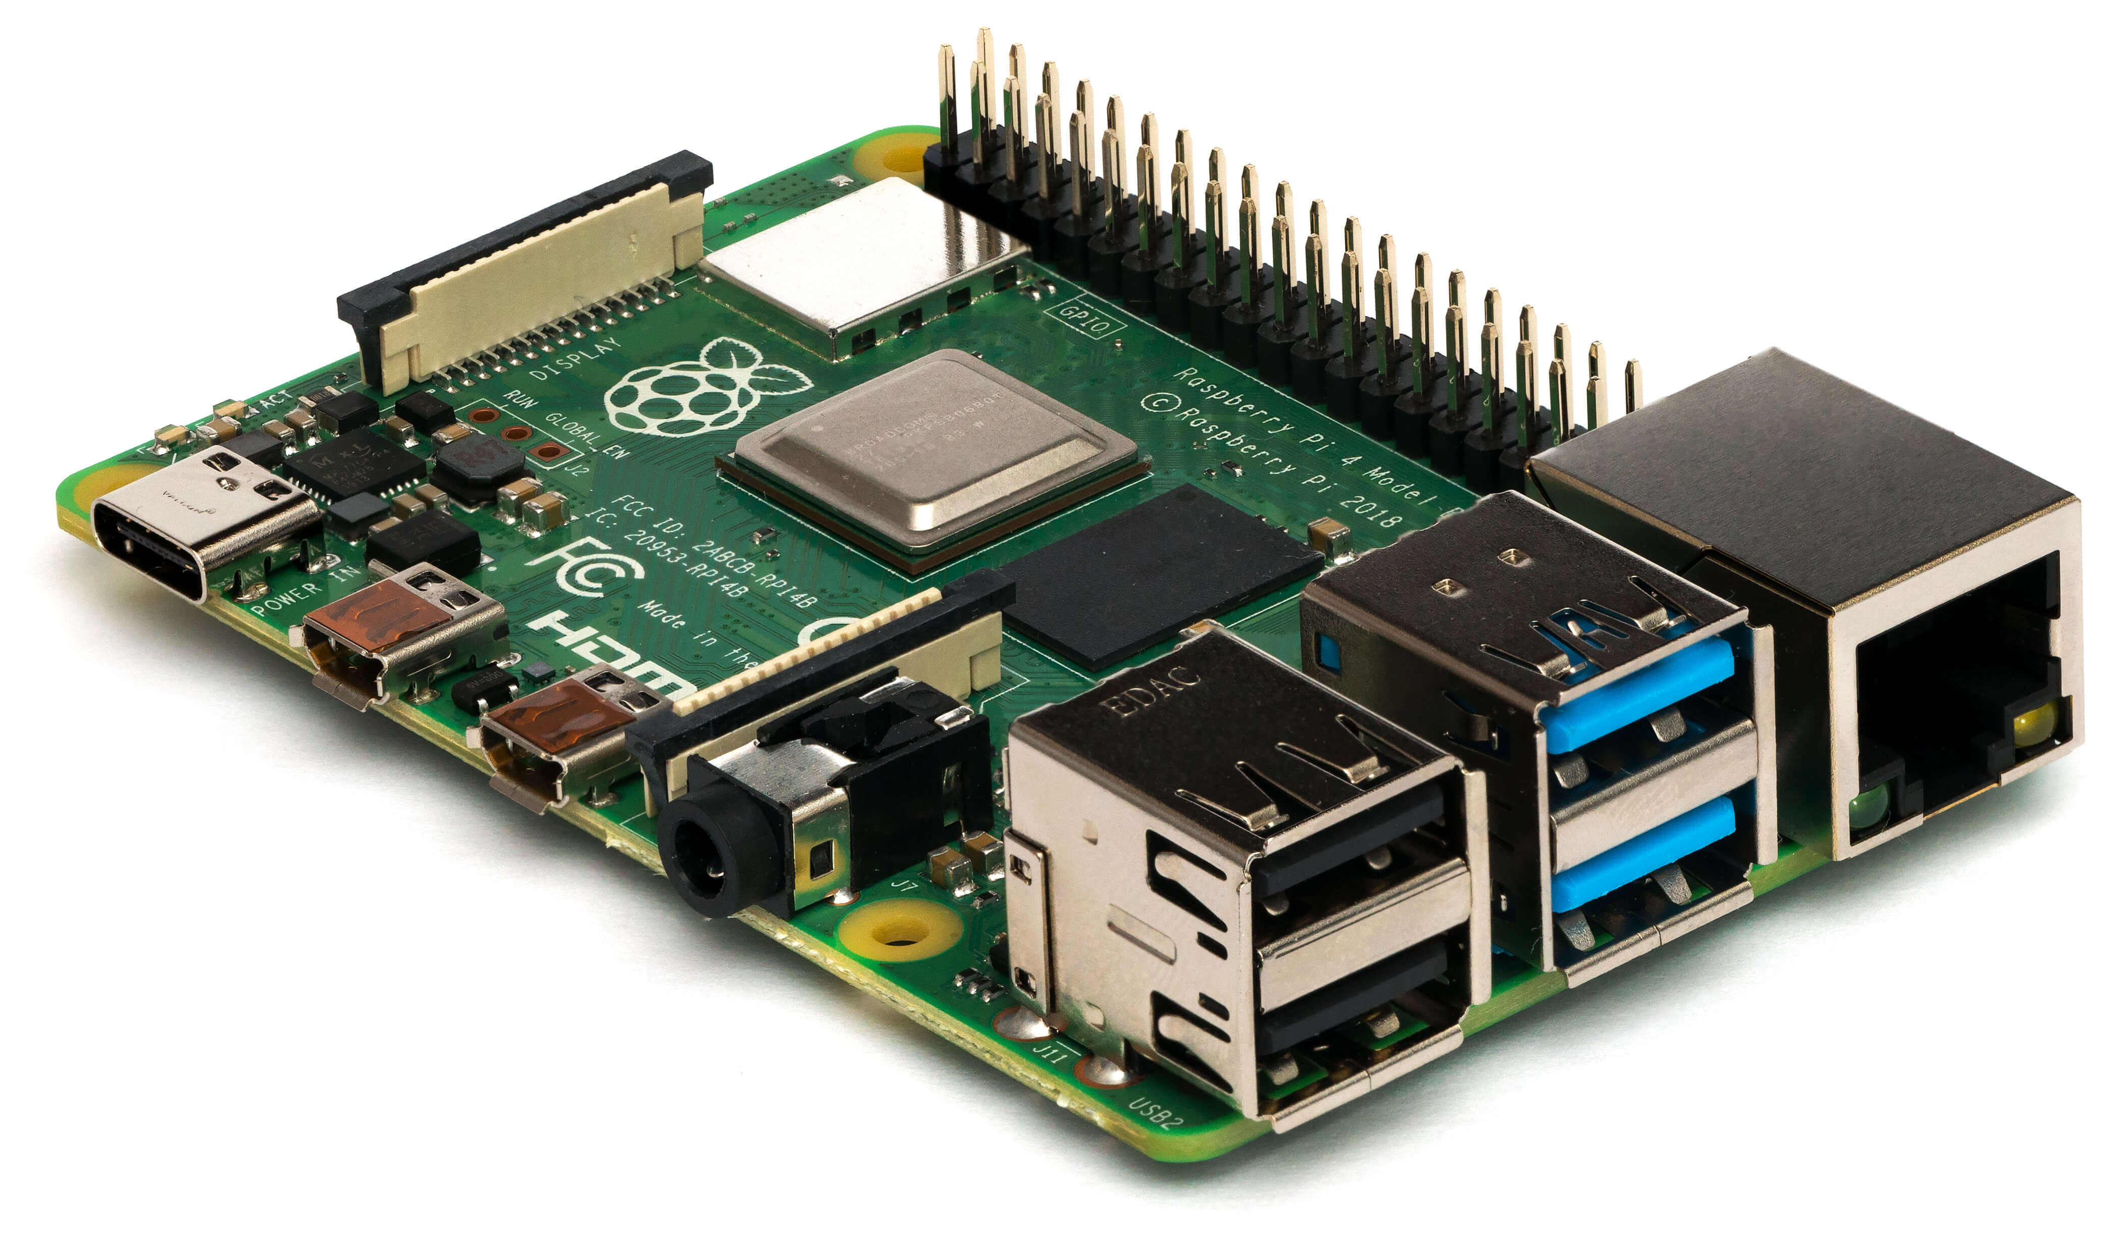
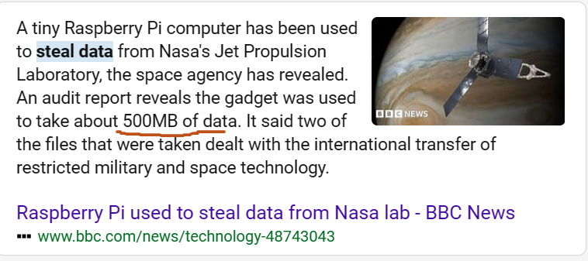
Raspberry Pi: Tiny Computer
Meet Raspberry Pi
Pocket-Sized Powerhouse
Learning and Fun
Innovation Playground
Affordable Access
Endless Creativity
Raspberry Pi

Slide 4
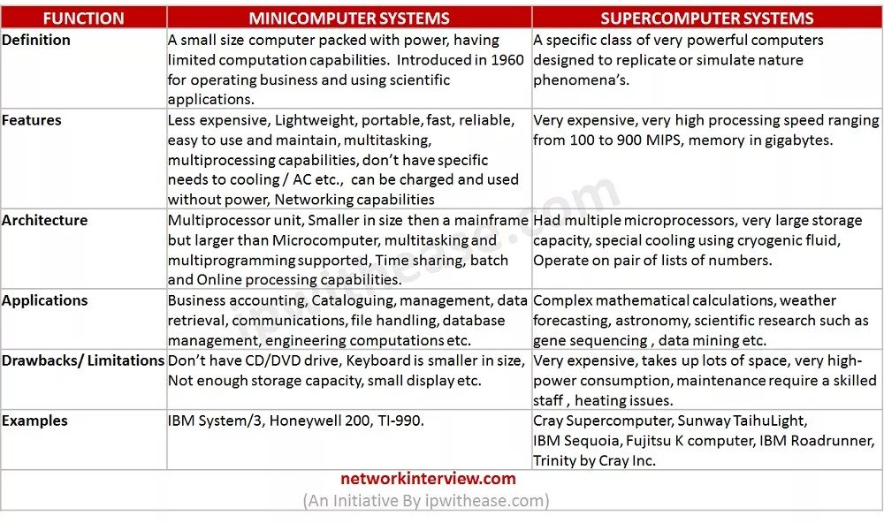
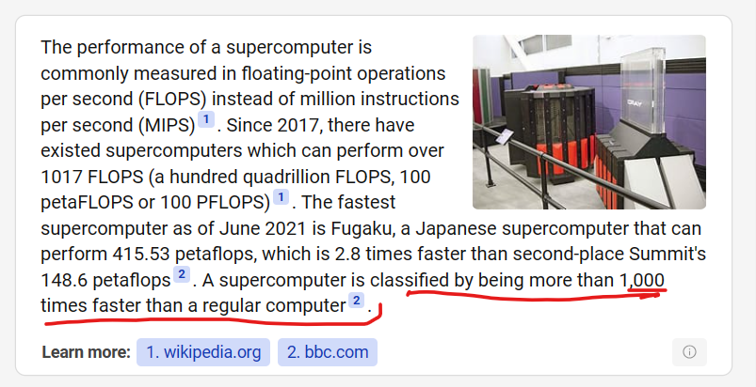
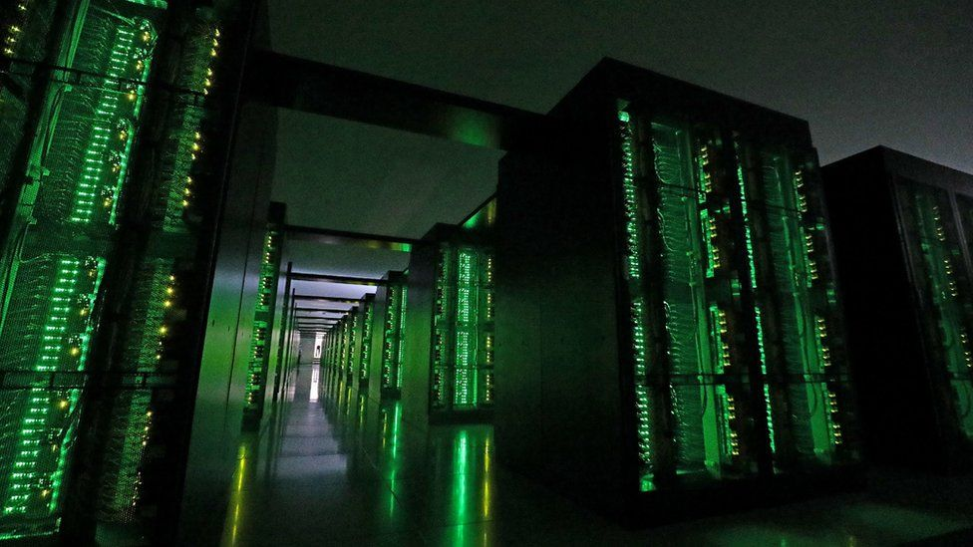
Supercomputers
Extreme Speed
Complex Simulations
Scientific Marvels
Endless Possibilities
Engineering Wonders
Healthcare Insights
SuperComputer

Slide 5
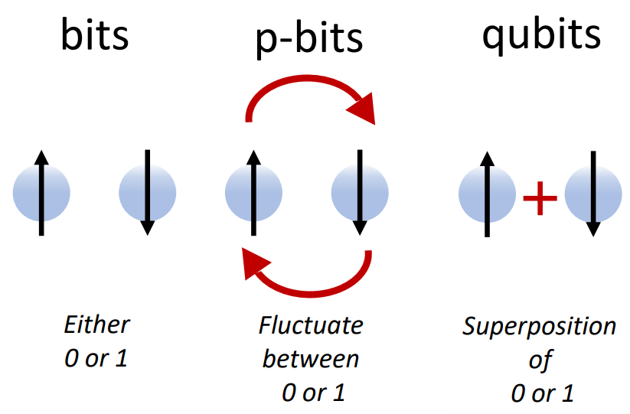
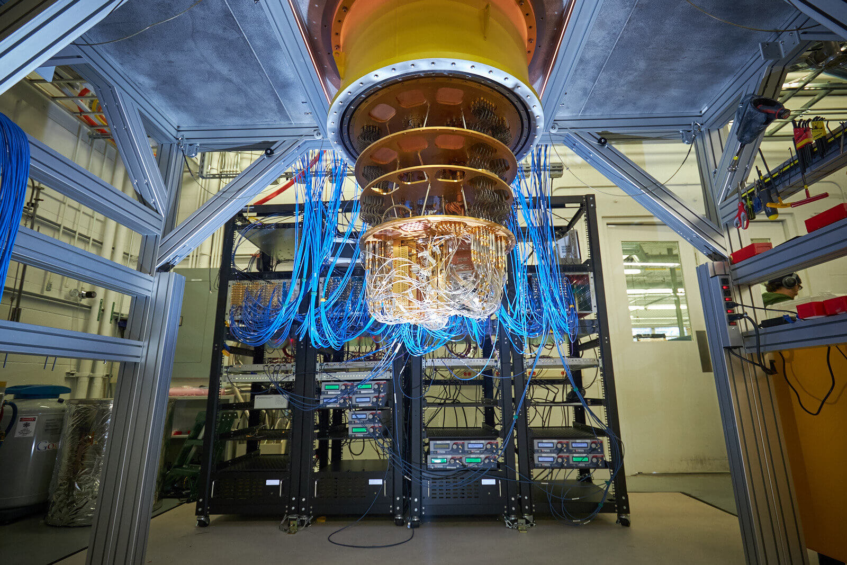
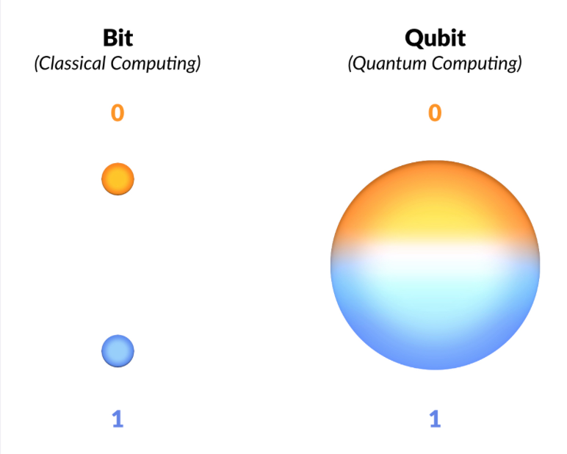
Quantum Computers
Enter Quantum Realm
Quantum Bits (Qubits)
Parallel Processing
Unleashing Potential
Speed Demons
Challenges Ahead
Quantum Computer

Slide 6
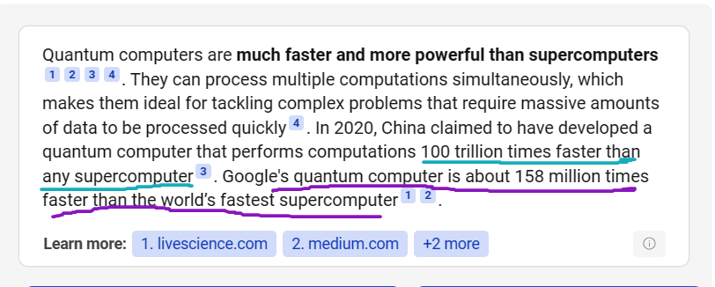
Super Computer Vs Quantum Computers

Slide 7
Changing the World: Impact and Future
Digital Revolution: Computers are changing the way we live, work, and communicate.
Smart Healthcare: Computers are making healthcare better.
Creativity Boost: Computers are making it easier and faster to be creative.
Quantum Possibilities: Quantum computers unlock medicine, energy breakthroughs.
AI Revolution: Artificial Intelligence is evolving, driving automation and insights across industries.
Metaverse Dreams: The Metaverse lets us jump into a pretend world where anything's possible.
Global Connection: Computers are connecting people all over the world.
Next Steps: We can use computers to make the world a better place.

